Slide 1
Bayesian Belief Networks

Slide 2
Bayesian Belief Networks
probabilistic graphical models, which unlike naïve Bayesian classifiers allow the representation of dependencies among subsets of attributes.
The na¨ıve Bayesian classifier makes the assumption of class conditional independence,
that is, given the class label of a tuple, the values of the attributes are assumed to be conditionally independent of one another.
This simplifies computation.
When the assumption holds true, then the naïve Bayesian classifier is the most accurate in comparison with all other classifiers.
In practice, however, dependencies can exist between variables.

Slide 3
Bayesian Belief Networks
Bayesian belief networks specify joint conditional probability distributions.
They allow class conditional independencies to be defined between subsets of variables.
They provide a graphical model of causal relationships, on which learning can be performed.
Trained Bayesian belief networks can be used for classification.
Bayesian belief networks are also known as belief networks, Bayesian networks, and probabilistic networks.

Slide 4
Bayesian Belief Networks
A belief network is defined by two components
a directed acyclic graph and
a set of conditional probability tables.
Each node in the directed acyclic graph represents a random variable.
The variables may be discrete- or continuous-valued.
They may correspond to actual attributes given in the data or to “hidden variables” believed to form a relationship (e.g., in the case of medical data, a hidden variable may indicate a syndrome, representing a number of symptoms that, together, characterize a specific disease).
Each arc represents a probabilistic dependence.
If an arc is drawn from a node Y to a node Z, then Y is a parent or immediate predecessor of Z, and Z is a descendant of Y.
Each variable is conditionally independent of its nondescendants in the graph, given its parents.

Slide 5
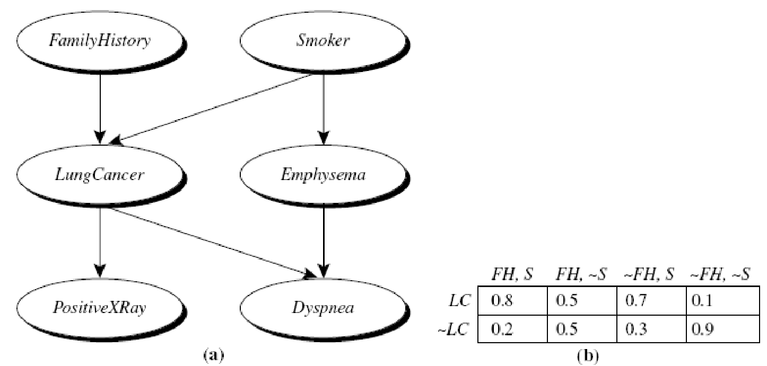
Simple Bayesian belief network

Slide 6
how Bayesian belief network is trained for classification
To train a Bayesian network, the algorithm first constructs the DAG, either manually or using an algorithm such as the K2 algorithm or the Hill-Climbing algorithm.
Once the DAG is constructed, the Bayesian belief networks (BBNs) learns the CPDs (called parameter learning) for each node in the network.
which involves estimating the parameters (i.e., the conditional probabilities) of the network from data.
There are different methods for parameter learning in BBNs, but one common approach is called maximum likelihood estimation (MLE),
which involves finding the values of the probabilities that maximize the likelihood of the training data.
To learn the CPD for a node, the algorithm counts the frequencies of each possible combination of values of the node and its parents in the training data, and uses these counts to estimate the probability distribution.

Slide 7
There are different methods for estimating the CPDs from the training data, depending on the type of node and the available data.
For discrete nodes, the most common method is the maximum likelihood estimation (MLE), which estimates the probabilities by counting the frequencies of each combination of values.
For continuous nodes, other methods such as maximum likelihood estimation with Gaussian distributions or kernel density estimation may be used.

Slide 8
Test the BBN
Once the CPDs are learned for each node in the network, the Bayesian network can be used for inference and prediction on new data.
During inference, the algorithm uses the network to calculate the posterior probability distribution of a target variable (posterior probability of each class) given observed evidence, using the learned CPDs and the network structure to propagate the probabilities through the network.

Slide 9
Refine the BBN
By repeating these steps with different sets of training and test data, we can iteratively improve the performance of the BBN and adjust the structure and parameters of the network as needed.
If we discover that a certain variable is not having the expected impact on the probability of the disease, we may need to adjust its assigned probability or its dependencies with other variables.

Slide 10
Estimating the probabilities in the CPTs for the given dataset for classification
Suppose we have a dataset of 10 instances with two input features, X and Y, and a binary class label, Z:
| X | Y | Z |
|------|------|------|
| 0 | 0 | 0 |
| 0 | 1 | 1 |
| 0 | 1 | 1 |
| 1 | 0 | 0 |
| 1 | 0 | 0 |
| 1 | 0 | 0 |
| 1 | 1 | 1 |
| 1 | 1 | 1 |
| 1 | 1 | 1 |
| 1 | 1 | 1 |

Slide 11
Estimate P(X) and P(Y):
Estimate P(Z|X,Y):
P(X=0) = 2/10 = 0.2
P(X=1) = 8/10 = 0.8
P(Y=0) = 4/10 = 0.4
P(Y=1) = 6/10 = 0.6
P(Z=0|X=0,Y=0) = 1/2 = 0.5
P(Z=1|X=0,Y=1) = 2/2 = 1.0
P(Z=0|X=1,Y=0) = 3/4 = 0.75
P(Z=1|X=1,Y=0) = 1/4 = 0.25
P(Z=1|X=1,Y=1) = 4/6 = 0.67
P(Z=0|X=1,Y=1) = 2/6 = 0.33

Slide 12
Example of a Bayesian belief network
involving weather and whether someone carries an umbrella.
The network has two nodes: "Weather" and "Carry Umbrella". The "Weather" node can be either "sunny" or "rainy", and the "Carry Umbrella" node can be either "yes" or "no".
Here's a Conditional Probability Table (CPT) for the "Carry Umbrella" node based on different weather conditions:
Weather | P(Carry Umbrella = yes) | P(Carry Umbrella = no)
Sunny | 0.1 | 0.9
Rainy | 0.8 | 0.2

Slide 13
Now, let's say we observe that it is raining outside. We want to update our belief about whether someone is likely to carry an umbrella given this new evidence.
Initially, without any evidence, the probabilities of carrying an umbrella would be according to the unconditional probabilities:
P(Carry Umbrella = yes) = 0.1 (for sunny) + 0.8 (for rainy) = 0.9
P(Carry Umbrella = no) = 0.9 (for sunny) + 0.2 (for rainy) = 0.1
Now, after observing that it's raining, we want to update these probabilities based on this evidence.
Using Bayes' theorem, we can compute the posterior probabilities:
P(CarryUmbrella=yes∣Rainy)=[P(Rainy∣CarryUmbrella=yes)×P(CarryUmbrella=yes)]/P(Rainy)

Slide 14
We already have the values for the prior probabilities from the CPT. The likelihoods
P(Rainy∣CarryUmbrella) can be read directly from the CPT as well.
P(Rainy∣CarryUmbrella=yes)=0.8
P(Rainy∣CarryUmbrella=no)=0.2
P(Rainy)=P(Rainy∣CarryUmbrella=yes)×P(CarryUmbrella=yes)+P(Rainy∣CarryUmbrella=no)×P(CarryUmbrella=no)
=0.8×0.9+0.2×0.1=0.72+0.02=0.74
=0.8×0.9+0.2×0.1=0.72+0.02=0.74
Now, we can compute the posterior probabilities:
P(CarryUmbrella=yes∣Rainy)==0.8×0.90]/.74≈0.97

Slide 15
P(CarryUmbrella=no∣Rainy)=0.2×0.10.74≈0.03
So, after observing that it's raining, the updated probabilities of someone carrying an umbrella are approximately 0.97 for "yes" and 0.03 for "no". This reflects the increased likelihood of someone carrying an umbrella when it's raining.

Slide 16
another example:
Bayesian belief network representing the relationship between a person's symptoms and whether they have the flu. The network has three nodes: "Flu", "Fever", and "Cough". "Flu" is the parent node, and "Fever" and "Cough" are its children nodes.
Here's a simplified version of the Conditional Probability Table (CPT) for each node:
Flu:
P(Flu = yes) = 0.05 (5% of the population has the flu)
P(Flu = no) = 0.95
Fever:
P(Fever = yes | Flu = yes) = 0.9 (90% chance of having a fever if you have the flu)
P(Fever = yes | Flu = no) = 0.2 (20% chance of having a fever if you don't have the flu)
Cough:
P(Cough = yes | Flu = yes) = 0.8 (80% chance of having a cough if you have the flu)
P(Cough = yes | Flu = no) = 0.1 (10% chance of having a cough if you don't have the flu)

Slide 17
Now, let's say we observe that a person has a fever. We want to update our belief about whether they have the flu based on this new evidence.
Using Bayes' theorem, we can compute the posterior probabilities:
P(Flu=yes∣Fever=yes)=
P(Fever=yes)
P(Fever=yes∣Flu=yes)×P(Flu=yes)
P(Flu=no∣Fever=yes)=
P(Fever=yes)
P(Fever=yes∣Flu=no)×P(Flu=no)

Slide 18
First, we compute the denominator
P(Fever=yes):
P(Fever=yes)=P(Fever=yes∣Flu=yes)×P(Flu=yes)+P(Fever=yes∣Flu=no)×P(Flu=no)
=0.9×0.05+0.2×0.95=0.045+0.19=0.235
=0.9×0.05+0.2×0.95=0.045+0.19=0.235

Slide 19
Now, we can compute the posterior probabilities:
P(Flu=yes∣Fever=yes)=
0.9×0.050.235≈0.0450.235≈0.191
P(Flu=no∣Fever=yes)=0.2×0.950.235≈0.190.235≈0.809
So, after observing that a person has a fever, the updated probabilities of them having the flu are approximately 0.191 for "yes" and 0.809 for "no".

Slide 20
How to find the class label
C= argmax P(c_{i}|x₁,x₂,….x_{n})
C = argmax P((x₁,x₂,…x_{n})|c_{i}) x P(c_{i})
P((x₁,x₂,…x_{n})|c_{i})= P(x₁|parent(x₁), c_{i})……………………P(X_{n}|parent(x_{n}), c_{i})
C= argmax P(c_{i}) x Πj=1 to n P(x_{j}|parent(x_{j}), c_{i})

